Slide 1
CS 106A, Lecture 21 Classes
suggested reading:
Java Ch. 6

Slide 2
Plan for today
Recap: HashMaps + What’s Trending
Classes
Practice: Employee
toString
Recap

Slide 3
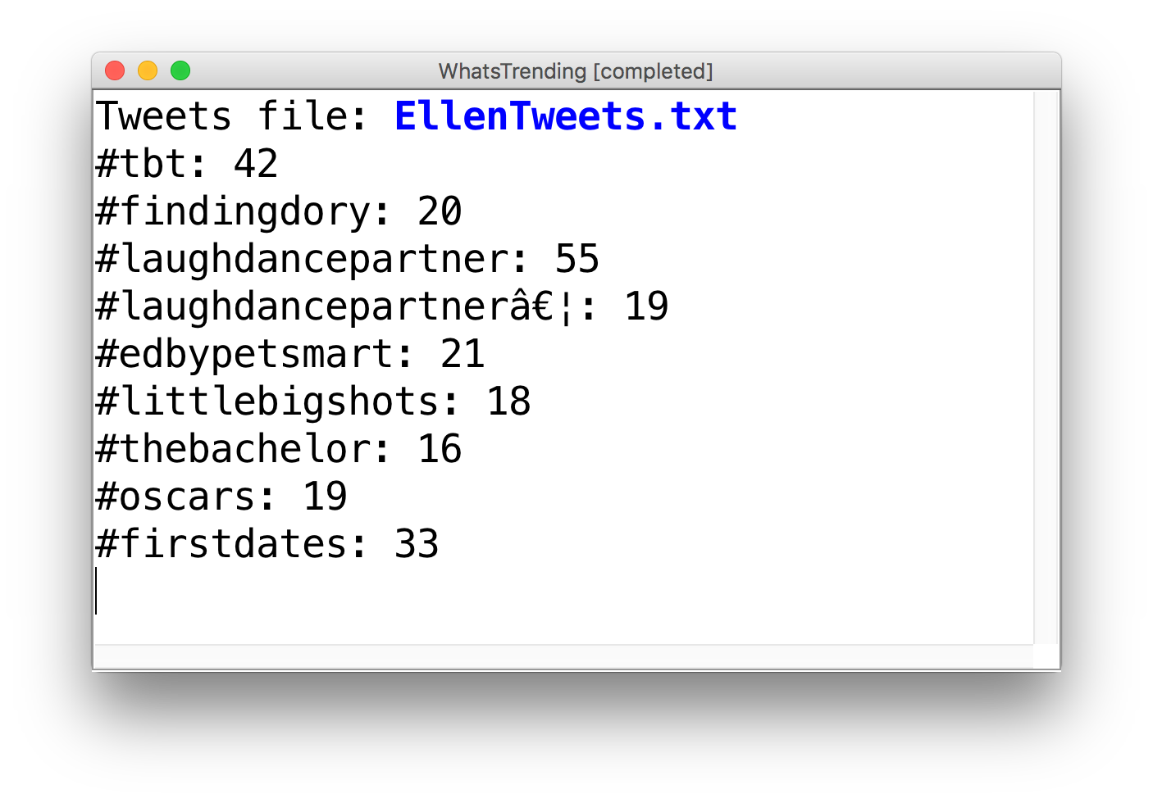
Recap: HashMaps

Slide 4
Plan for today
Recap: HashMaps + What’s Trending
Classes
Practice: Employee
toString
Recap

Slide 5
Large Java Programs
There are some large programs written in Java!
Notes:
How? Custom variable types

Slide 6
Defining New Variable Types
Inbox Database
Email Sender
Login Manager
Email
User
Inbox

Slide 7
What Is A Class?
A class defines a new variable type.

Slide 8
Why Is This Useful?
A student registration system needs to store info about students, but Java has no Student variable type.
A music synthesizer app might want to store information about different types of instruments, but Java has no Instrument variable type.
An email program might have many emails that need to be stored, but Java has no Email variable type.
Classes let you define new types of variables, which lets you decompose your program code across different files.
Notes:
Let you decompose your program across files

Slide 9


Classes Are Like Blueprints
iPod blueprint (class)
state: current song volume battery life
behavior: power on/off change station/song change volume choose random song
constructs
iPod (variable) #1
state: song = "1,000,000 Miles" volume = 17 battery life = 2.5 hrs
behavior: power on/off change station/song change volume choose random song
iPod (variable) #2
state: song = "Letting You" volume = 9 battery life = 3.41 hrs
behavior: power on/off change station/song change volume choose random song
iPod (variable) #3
state: song = "Discipline" volume = 24 battery life = 1.8 hrs
behavior: power on/off change station/song change volume choose random song

Slide 10
What Is A Class?
A class defines a new variable type.

Slide 11
Creating A New Class
Let’s define a new variable type called BankAccount that represents information about a single person’s bank account.
A BankAccount:
- contains the name of account holder
- contains the balance
- can deposit money
- can withdraw money

Slide 12
What if…
What if we could write a program like this:
BankAccount nickAccount = new BankAccount();
nickAccount.setName(“Nick”);
nickAccount.deposit(50);
BankAccount rishiAccount = new BankAccount();
rishiAccount.setName(“Rishi”);
rishiAccount.deposit(50);
boolean success = rishiAccount.withdraw(10);
if (success) {
println(“Rishi withdrew $10.”);
}

Slide 13
Creating A New Class
What information is inside this new variable type? These are its private instance variables.

Slide 14
Example: BankAccount
// In file BankAccount.java
public class BankAccount {
// Step 1: the data inside a BankAccount
private String name;
private double balance;
}
Each BankAccount object has its own copy
of all instance variables.
Notes:
Not really useful if we can’t do anything with this though!

Slide 15
Creating A New Class
What information is inside this new variable type? These are its instance variables.
What can this new variable type do? These are its public methods.

Slide 16
What if…
What if we could write a program like this:
BankAccount nickAccount = new BankAccount();
nickAccount.setName(“Nick”);
nickAccount.deposit(50);
println(nickAccount);
BankAccount rishiAccount = new BankAccount();
rishiAccount.setName(“Rishi”);
rishiAccount.deposit(50);
boolean success = rishiAccount.withdraw(10);
if (success) {
println(“Rishi withdrew $10.”);
}

Slide 17
Example: BankAccount
public class BankAccount {
// Step 1: the data inside a BankAccount
private String name;
private double balance;
// Step 2: the things a BankAccount can do
public void deposit(double amount) {
balance += amount;
}
public boolean withdraw(double amount) {
if (balance >= amount) {
balance -= amount;
return true;
}
return false;
}
}
Notes:
Methods are public so other files can access them

Slide 18
Defining Methods In Classes
ba1
Methods defined in classes can be called
on an instance of that class.
When one of these methods executes,
it can reference that object’s copy of
instance variables.
ba1.deposit(0.20);
ba2.deposit(1000.00);
This means calling one of these methods on different objects has
different effects.
name = "Marty"
balance = 1.45
deposit(amount) {
balance += amount;
}
ba2
name = "Mehran"
balance = 901000.00
deposit(amount) {
balance += amount;
}

Slide 19
Getters and Setters
Instance variables in a class should always be private. This is so only the object itself can modify them, and no-one else.
To allow the client to reference them, we define public methods in the class that set an instance variable’s value and get (return) an instance variable’s value. These are commonly known as getters and setters.
account.setName(“Nick”);
String accountName = account.getName();
Getters and setters prevent instance variables from being tampered with.

Slide 20
Example: BankAccount
public class BankAccount {
private String name;
private double balance;
...
public void setName(String newName) {
if (newName.length() > 0) {
name = newName;
}
}
public String getName() {
return name;
}
}

Slide 21
Creating A New Class
What information is inside this new variable type? These are its instance variables.
What can this new variable type do? These are its public methods.
How do you create a variable of this type? This is the constructor.

Slide 22
Constructors
GRect rect = new GRect();
GRect rect2 = new GRect(50, 50);
This is calling a special method! The GRect constructor.

Slide 23
Constructors
BankAccount ba1 = new BankAccount();
BankAccount ba2 = new BankAccount(“Nick”, 50);
The constructor is executed when a new object is created.

Slide 24
Example: BankAccount
public class BankAccount {
// Step 1: the data inside a BankAccount
private String name;
private double balance;
// Step 2: the things a BankAccount can do (omitted)
// Step 3: how to create a BankAccount
public BankAccount(String accountName, double startBalance) {
name = accountName;
balance = startBalance;
}
public BankAccount(String accountName) {
name = accountName;
balance = 0;
}
}
Notes:
Methods are public so other files can access them

Slide 25
Using Constructors
ba1
BankAccount ba1 =
new BankAccount("Marty", 1.25);
BankAccount ba2 =
new BankAccount("Mehran", 900000.00);
When you call a constructor (with new):
Java creates a new object of that class.
The constructor runs, on that new object.
The newly created object is returned to your program.
name = "Marty"
balance = 1.25
BankAccount(nm, bal) {
name = nm;
balance = bal;
}
ba2
name = "Mehran"
balance = 900000.00
BankAccount(nm, bal) {
name = nm;
balance = bal;
}

Slide 26
Constructors
constructor: Initializes the state of new objects as they are created.
public ClassName(parameters) {
statements;
}
The constructor runs when the client says new ClassName(...);
no return type is specified; it "returns" the new object being created
If a class has no constructor, Java gives it a default constructor with no parameters that sets all fields to default values like 0 or null.

Slide 27
What Is A Class?
A class defines a new variable type.

Slide 28
Creating A New Class
What information is inside this new variable type? These are its instance variables.
What can this new variable type do? These are its public methods.
How do you create a variable of this type? This is the constructor.

Slide 29
Plan for today
Recap: HashMaps + What’s Trending
Classes
Practice: Employee
toString
Recap

Slide 30
Practice: Employee
Let’s define a new variable type called Employee that represents a single Employee.
What information would an Employee store?
What could an Employee do?
How would you create a new Employee variable?

Slide 31
Plan for today
Recap: HashMaps + What’s Trending
Classes
Practice: Employee
toString
Recap

Slide 32
Printing Variables
By default, Java doesn't know how to print objects.
// ba1 is BankAccount@9e8c34
BankAccount ba1 = new BankAccount("Marty", 1.25);
println("ba1 is " + ba1);
// better, but cumbersome to write
// ba1 is Marty with $1.25
println("ba1 is " + ba1.getName() + " with $"
+ ba1.getBalance());
// desired behavior
println("b1 is " + ba1); // ba1 is Marty with $1.25

Slide 33
The toString Method
A special method in a class that tells Java how to convert an object into a string.
BankAccount ba1 = new BankAccount("Marty", 1.25);
println("ba1 is " + ba1);
// the above code is really calling the following:
println("ba1 is " + ba1.toString());
Every class has a toString, even if it isn't in your code.
Default: class's name @ object's memory address (base 16)
BankAccount@9e8c34

Slide 34
The toString Method
public String toString() {
code that returns a String
representing this object;
}
Method name, return, and parameters must match exactly.
Example:
// Returns a String representing this account.
public String toString() {
return name + " has $" + balance;
}

Slide 35
Plan for today
Recap: HashMaps + What’s Trending
Classes
Practice: Employee
toString
Recap

Slide 36
What Is A Class?
A class defines a new variable type.

Slide 37
Creating A New Class
What information is inside this new variable type? These are its instance variables.
What can this new variable type do? These are its public methods.
How do you create a variable of this type? This is the constructor.

Slide 38
Recap
Recap: HashMaps + What’s Trending
Classes
Practice: Employee
toString
Recap
Next time: more classes

